Slide 1
Machine learning
Clustering

Slide 2
Supervised learning vs unsupervised learning
With labels – supervised
Classification
Regression
No labels – unsupervised
Clustering
Anomaly detection
Reinforcement learning
Etc.

Slide 3
What is Clustering?
the task of grouping a set of objects in such a way that objects in the same group (called a cluster) are more similar (in some sense or another) to each other than to those in other groups (clusters)

Slide 4
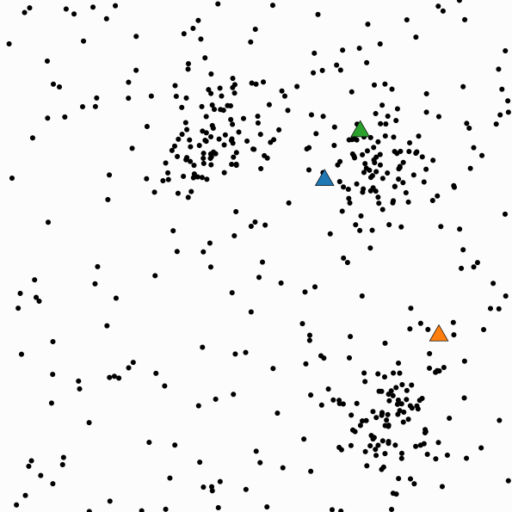
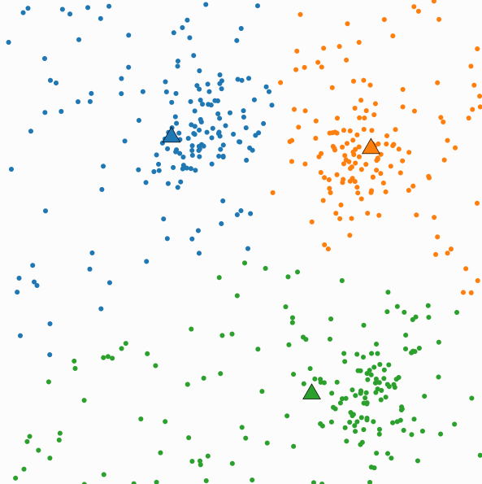
Clustering Example - Kmeans

Slide 5
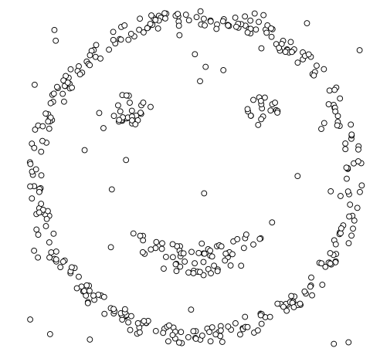
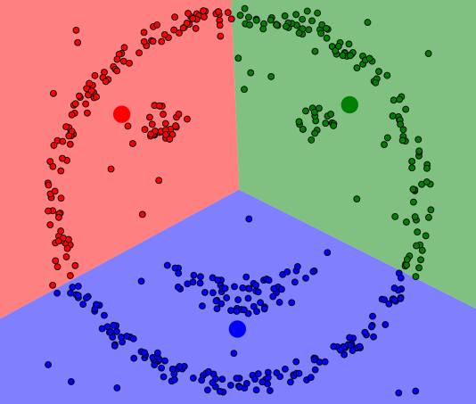
Clustering Example - Kmeans

Slide 6
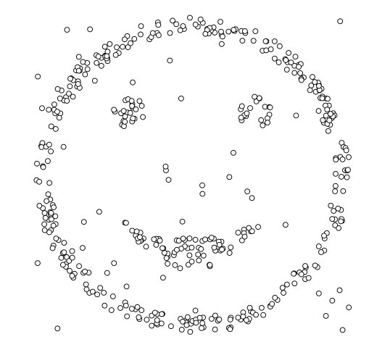
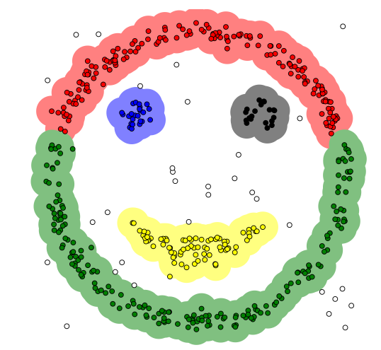
Clustering Example - DBSCAN

Slide 7
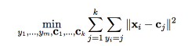
K-Means Clustering as an optimization problem
Goal : minimize the total within-cluster distances
Within-cluster sum squares (WCSS)
Mathematically: find centroids C and partition y so that:
minimize WCSS(C,y)

Slide 8
Optimizing method
Minimize d(y,C)
Initialize C
Keep C unchanged, optimize y
Assign each point to its closest centroid (assignment step)
Keep y unchanged, optimize C
Move centroid to the center of the cluster (update step)
http://stanford.edu/class/ee103/visualizations/kmeans/kmeans.html

Slide 9
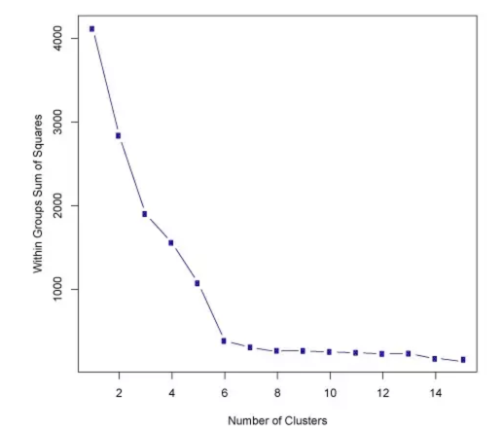
K-Means Usage
Sensitive to initialization
https://www.naftaliharris.com/blog/visualizing-k-means-clustering/
Manually choose number of clusters (k)
What is the value of K that gives you the min WCSS?

Slide 10
K-Means Variants
K-medoids
uses the medoid instead of the mean
K-means ++
chooses initial centers in a way that gives a provable upper bound on the WCSS objective.
…

Slide 11
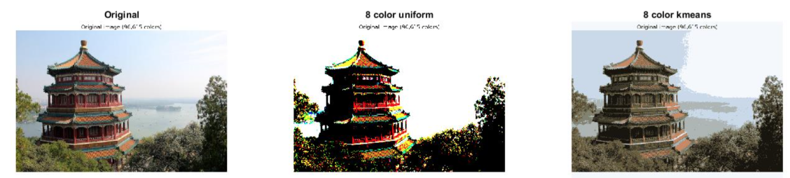
K-means/clustering Applications
Gap or other garment companies design the small size, medium size, large size.
Cluster traffic conditions to discretize traffic flow.
Compress color image

Slide 12
Hard partition vs. Soft/fuzzy partition
Hard partition:
K-means
K-medoids
Soft partition:
Fuzzy C-means
Gustafson-Kessel
Gath-Geva
membership | cluster1 | cluster2 | cluster3
point1 | 1 | 0 | 0
point2 | 0 | 0 | 1
membership | cluster1 | cluster2 | cluster3
point1 | 0.8 | 0.1 | 0.1
point2 | 0.3 | 0.2 | 0.5

Slide 13
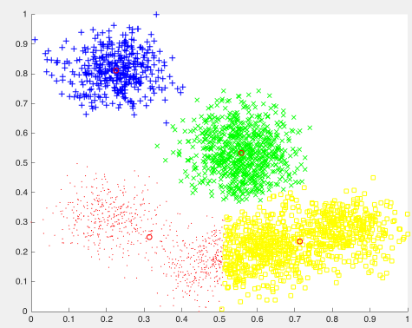
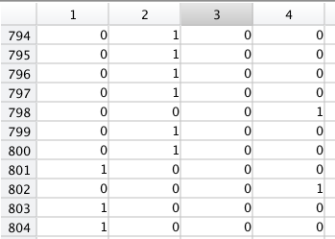
K-Means

Slide 14
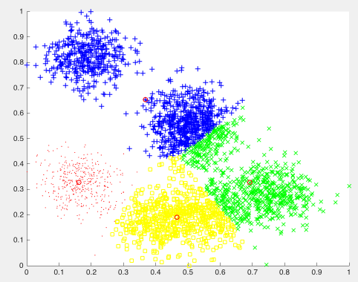
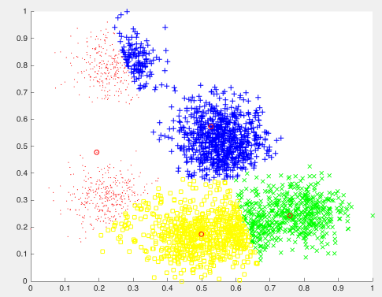
K-medoids

Slide 15
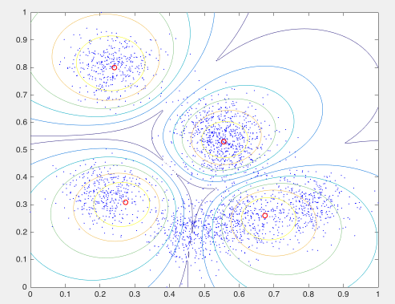
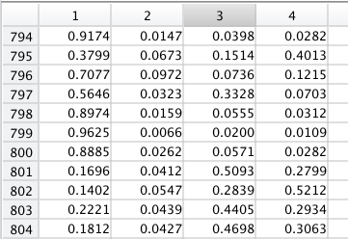
Fuzzy C-means
The algorithm can only detect clusters with circle shape.

Slide 16
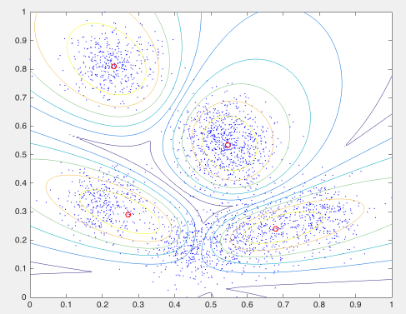
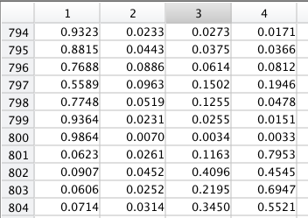
Gustafson-Kessel
GK algorithm can find only clusters with approximately equal volumes

Slide 17
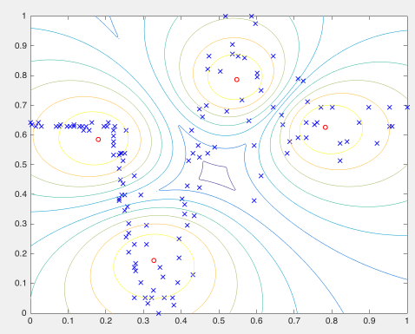
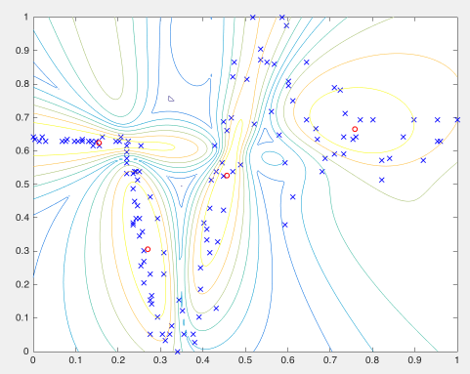
FCM (left) vs. GK (right)
FCM
GK

Slide 18
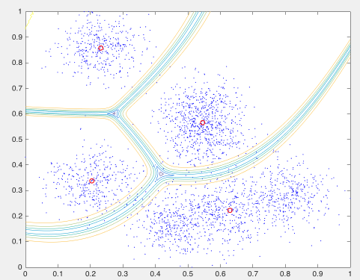
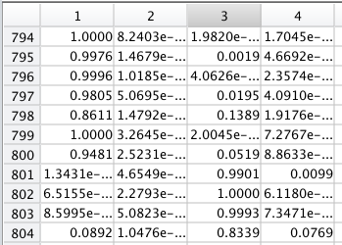
Gath-Geva
is able to detect clusters of varying shapes, sizes and densities
This algorithm is less robust in the sense that it needs a good initialization

Slide 19
Cluster by rule-based scanning
Hierarchical clustering
Top-down / bottom-up
single-link
Rule:
Each point belongs to its own cluster – start point
Each step merge two closest clusters
Distance between two clusters set equal to the minimum of distances between all instances

Slide 20
Single-link
E
D
F
C
B
A
G

Slide 21
Single-link
E
D
F
C
B
A
G

Slide 22
Single-link
E
D
F
C
B
A
G

Slide 23
Single-link
E
D
F
C
B
A
G

Slide 24
Single-link
Dendrogram
Divide into two clusters:
{A,B,C,D,E,F} and {G}
Divide into three clusters:
{A,B,C,D,E},{F},{G}
Etc.
A B C D E F G

Slide 25
Complete-link
Distance between two clusters set equal to maximum of all distances between instances in the clusters
E
D
F
C
B
A
G

Slide 26
Complete-link
E
D
F
C
B
A
G

Slide 27
Complete-link
E
D
F
C
B
A
G

Slide 28
Complete-link
E
D
F
C
B
A
G

Slide 29
Complete-link
E
D
F
C
B
A
G

Slide 30
Complete-link
Dendrogram
Divide into two clusters:
{A,B,C,D} and {E,F,G}
Divide into three clusters:
{A,B},{C,D},{E,F,G}
Etc.
A B C D E F G

Slide 31
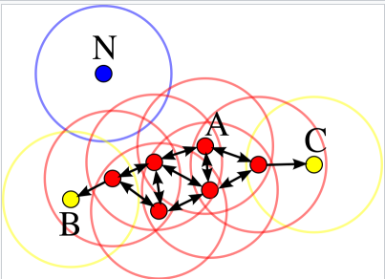
DBSCAN
Density-based spatial clustering of applications with noise (DBSCAN)
Rule:
Pick one point, draw a circle with a certain Radius
If the number of points in the circle >= minPts, then all these points belong to a same cluster
Keep scanning
D

Slide 32
DBSCAN Demo
Hard partition
https://www.naftaliharris.com/blog/visualizing-dbscan-clustering/
membership | cluster1 | cluster2 | cluster3
point1 | 0 | 0 | 0
point2 | 0 | 0 | 1

Slide 33
DBSCAN application
Find low speed event from heat map

Slide 34
Basic Lane Detection
By Image Processing

Slide 35
HOT TOPIC: Self-Driving Car
Level 0 – 4
free your feet
free your hands
free your eyes

Slide 36
Self-Driving Car sample tasks
Keep in lane (lane detection)
Object detection (vehicle, traffic signs, pedestrian)
Object tracking
Path planning
Control

Slide 37
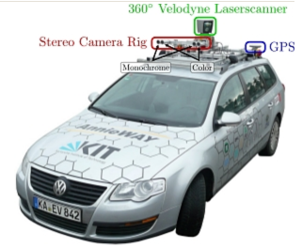
Sensors on self-driving car

Slide 38
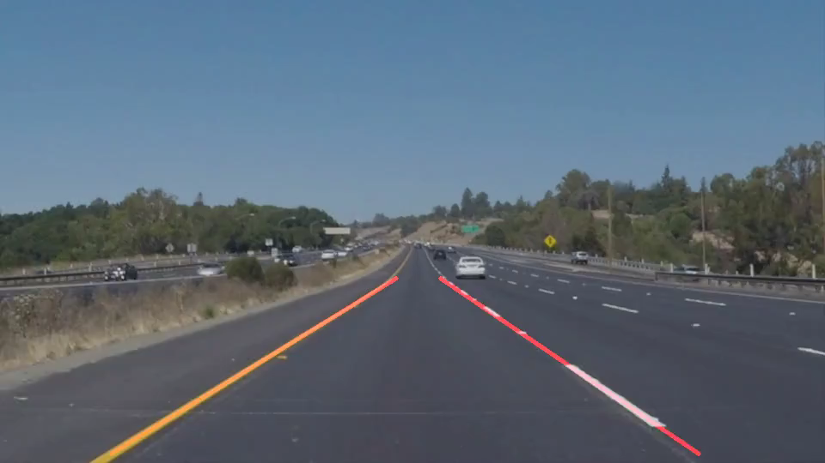
Basic lane detection

Slide 39
Everything start from an image
Image is a matrix
Pixel intensities are its values
fundamental calculation on matrix: Convolution
Demo: http://setosa.io/ev/image-kernels/

Slide 40
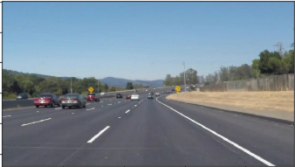
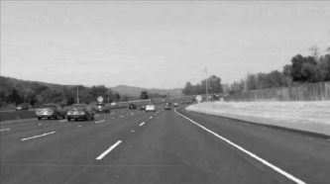
Basic lane detection by Image processing
Step 1 convert input image to gray scale

Slide 41
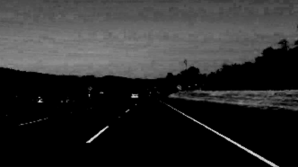
Basic lane detection by Image processing
Step2 increase the contrast

Slide 42
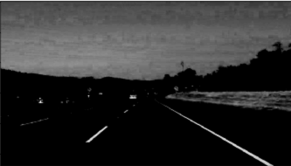
Basic lane detection by Image processing
Step 3: blur/smooth the image to remove noise

Slide 43
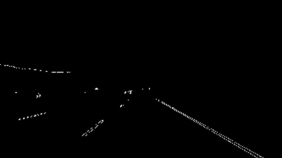
Basic lane detection by Image processing
Step 4 detect edges (canny edge detector)

Slide 44
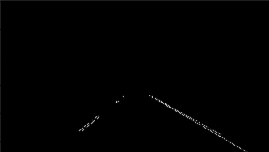
Basic lane detection by Image processing
Step 5 remove things outside the area of interest

Slide 45
Hough Transform
Demo: http://liquify.eu/project/HoughTransform/

Slide 46
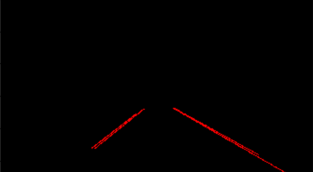
Basic lane detection by Image processing
Step 6 line detection by Hough transform

Slide 47
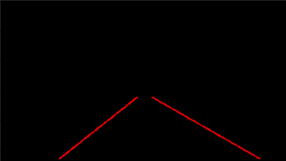
Basic lane detection by Image processing
Step 7 fit line and extrapolate

Slide 48
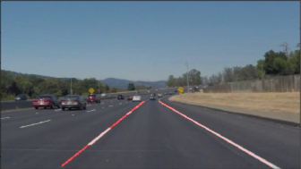
Basic lane detection by Image processing
Step 8 draw it back on the image

Slide 49
Basic lane detection

Slide 50
Keep in Lane
Directly map:
Detected lane orientation – steering angle
Leaning a mapping function:
Characteristic of the detected lane – steering angle
Basic lane detection – only detect straight lines.

Slide 51
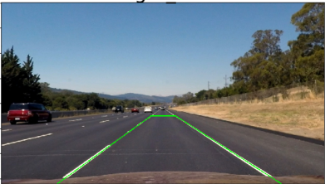
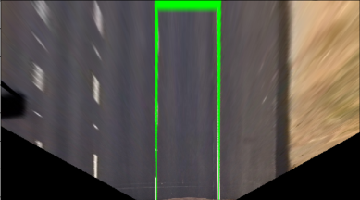
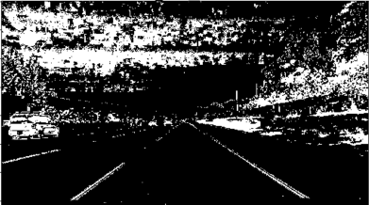
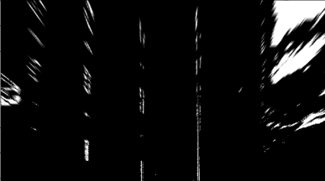
Advanced Lane Detection

Slide 52
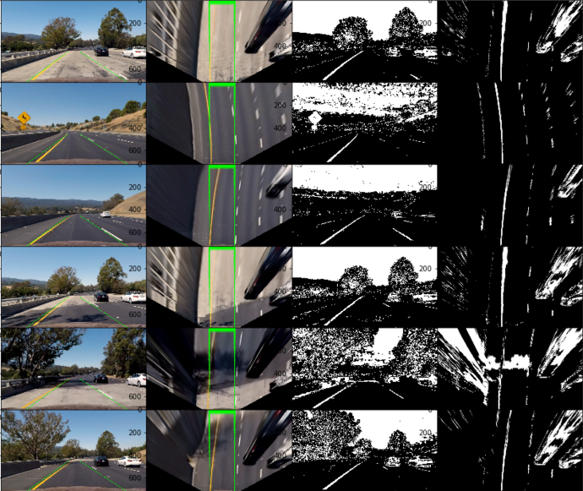

Slide 53
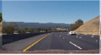
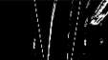
Advanced Lane Detection
Step N: create binary bird’s view

Slide 54
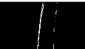
Advanced Lane Detection
Step N+1: remove things outside of area of interest

Slide 55
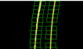
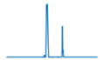
Advanced Lane Detection
Step N+2: bottom-up scan to find all lane points
Step N+3: use detected points to fit a poly line
Step N+4: use the fitted poly line to calculate lane orientation

Slide 56
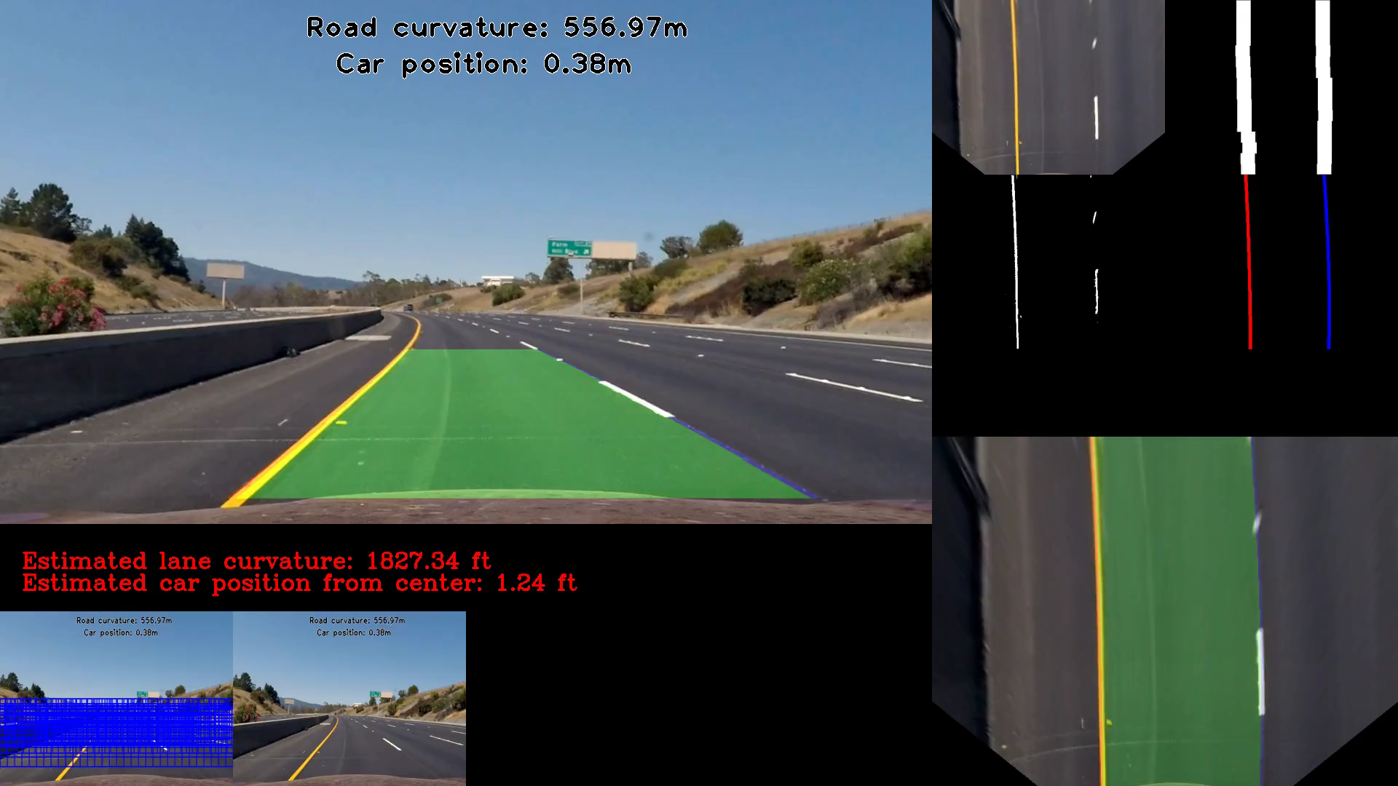
Advanced Lane Detection

Slide 57
Keep in lane
Image processing – lane lines – hand-crafted features
Image
Steering angle
Deep ANN
Image
Steering angle
End-to-end learning

